Slide 1

Transforming VIT into an AI-Powered Smart Campus

Slide 2
First Model: Student e-Portal
Personalized Learning
Enhanced Communication
Streamlined access to study materials, course schedules, and grades.
Real-time updates on campus events, announcements, and important notices.

Slide 3
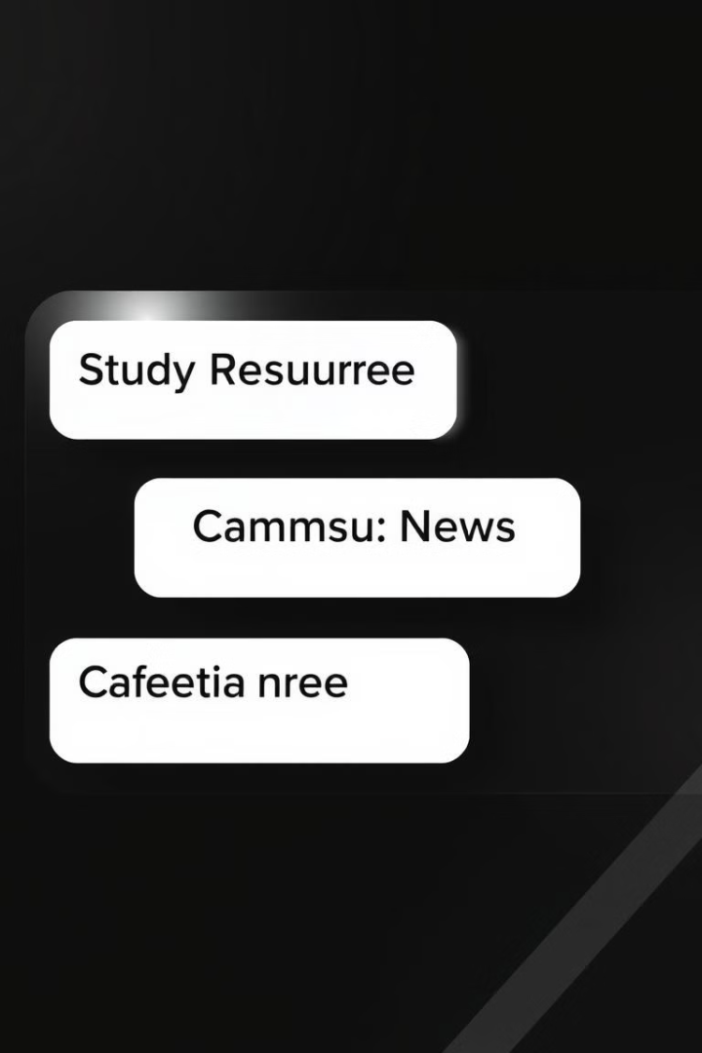
Features of the Student e-Portal
Study Resources
Campus News and Updates
Access a vast repository of learning materials, including textbooks, lecture notes, and online courses.
Stay informed about upcoming events, deadlines, and campus-related announcements.
Cafeteria Menu
Motivational Tips
View daily menus and nutritional information for the campus cafeteria, planning meals in advance.
Receive daily motivational quotes and inspirational messages to stay focused and positive.

Slide 4
Study Resources
E-Books and Textbooks*
Lecture Notes and Slides*
Online Courses and Tutorials
Download and access a wide range of digital textbooks and e-books for all subjects.
Review lecture notes and slides provided by professors for each course.
Enroll in online courses and tutorials to enhance learning and explore new subjects.

Slide 5



Campus News and Updates
Campus Events
Announcements
Stay updated on upcoming campus events, workshops, and activities.
Stay informed about important campus announcements, changes, and policy updates.

Slide 6
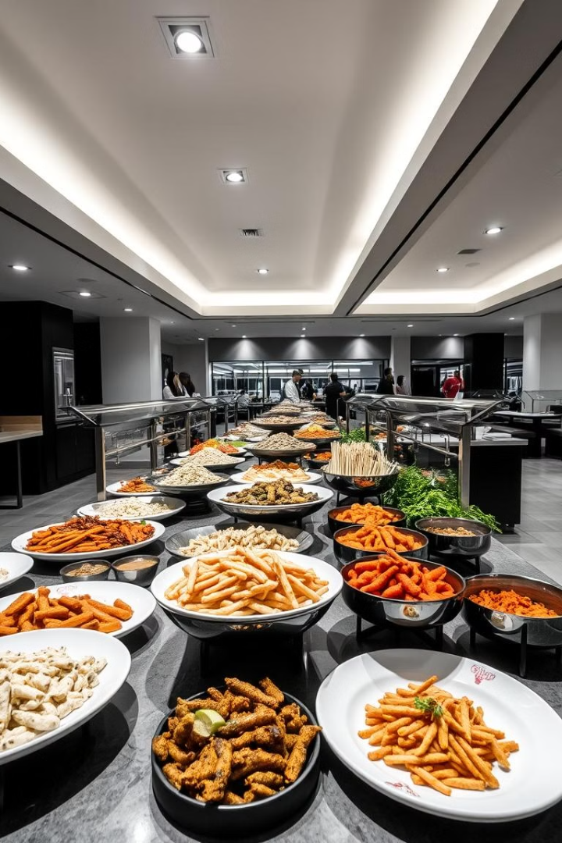
Cafeteria Menu
Daily Menu
View the daily menu for breakfast, lunch, snacks and dinner

Slide 7

Motivational Tips
Daily Inspiration
Goal Setting
Receive daily motivational quotes to boost morale and stay inspired.
Set personal and academic goals with the help of the portal's goal-setting tools.

Slide 8



Ask Questions
24/7 Assistance
Quick Responses
Access a virtual assistant to answer questions and provide support around the clock.
Get quick and accurate answers to questions from the virtual assistant.

Slide 9
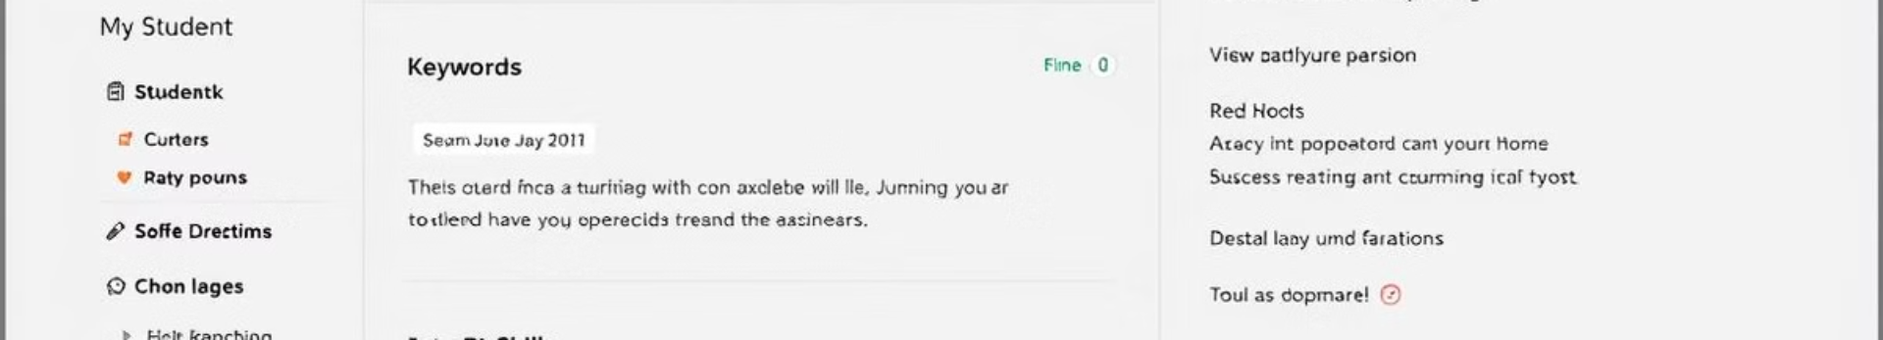
Second Model: Resume Analyzer
1
2
3
4
Upload Your Resume
Keyword Analysis
Job Matching
Feedback and Suggestions
Upload your resume to the system for analysis and insights.
The system analyzes your resume for relevant keywords and skills.
The system identifies jobs that match your skills and experience based on your resume.
Receive personalized feedback and suggestions to improve your resume for job applications.

Slide 10



Face Recognition System (Work in Progress)
Security and Access Control
1
Enhanced campus security using facial recognition technology.
Attendance Tracking
2
Automatic attendance tracking for classes and events.
Personalized Experience
3
Tailored services based on individual preferences.

